Slide 1

Introduction to
netism

Slide 2


Law of Magnetism
S
N
S
N
S
N
S
N
Unlike poles attract
Like poles repel
Magnetic Fields
S
N

Slide 3

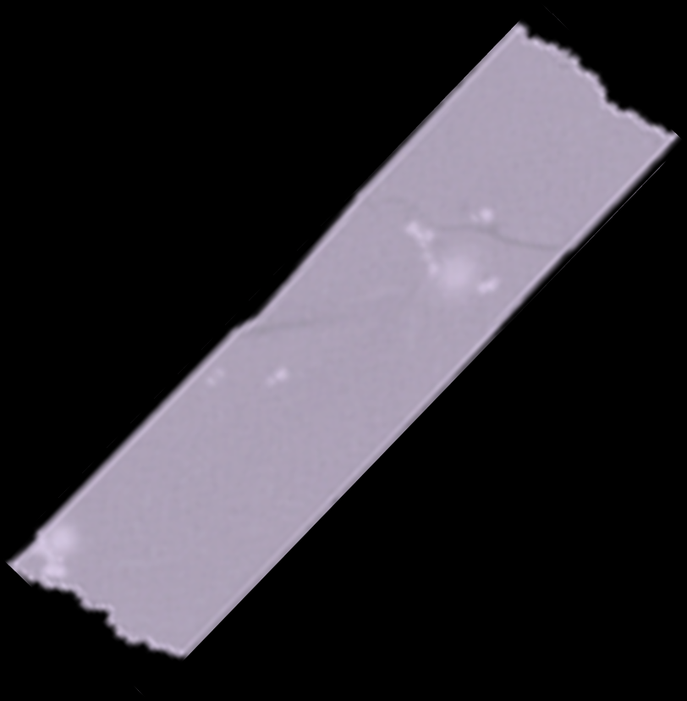
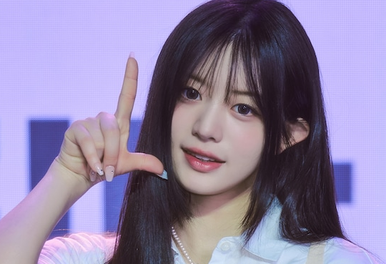
Law of Magnetism
S
N
S
N
S
N
S
N
Unlike poles attract
Like poles repel
Fleming’s Right Hand Rule
Magnetic Fields
Determine the direction of current in a generator's windings.
S
N
Magnetic field
Motion
Current

Slide 4
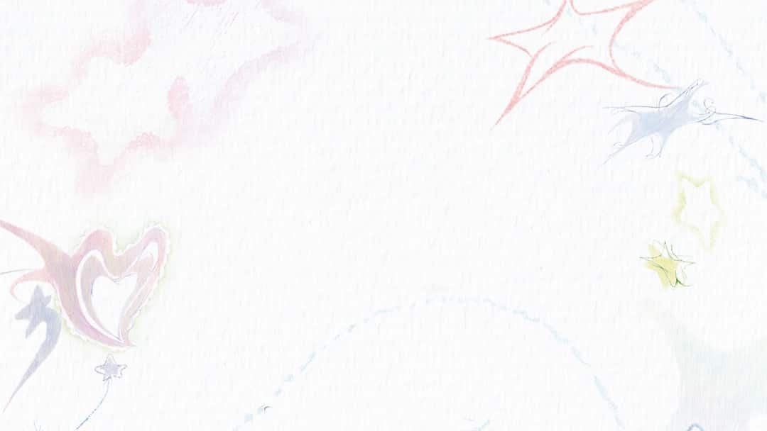
Magnetic Fields
S
N
Fleming’s Right Hand Rule
Determine the direction of current in a generator’s windings.
Magnetic field
Motion
Current

